Slide 1
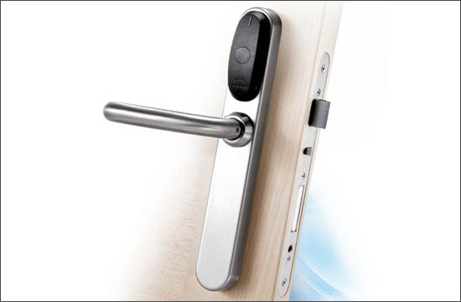
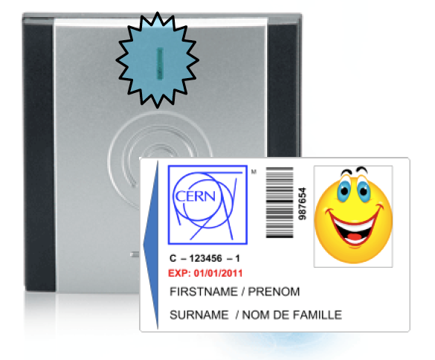
Electronic locks in control rooms

Slide 2
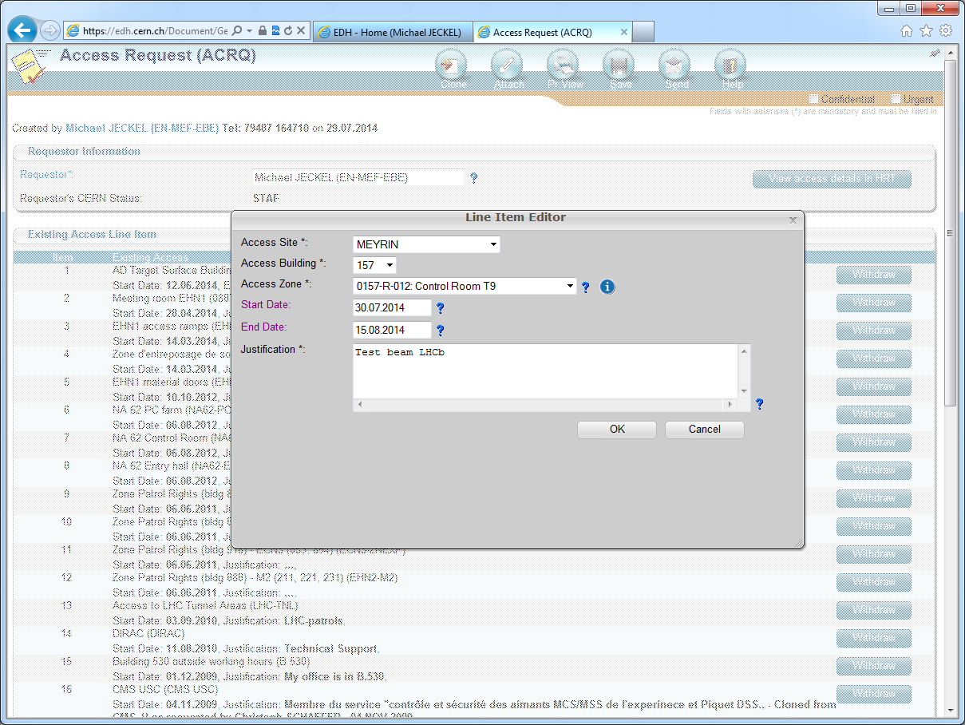
End of test beam plus one week

Slide 3
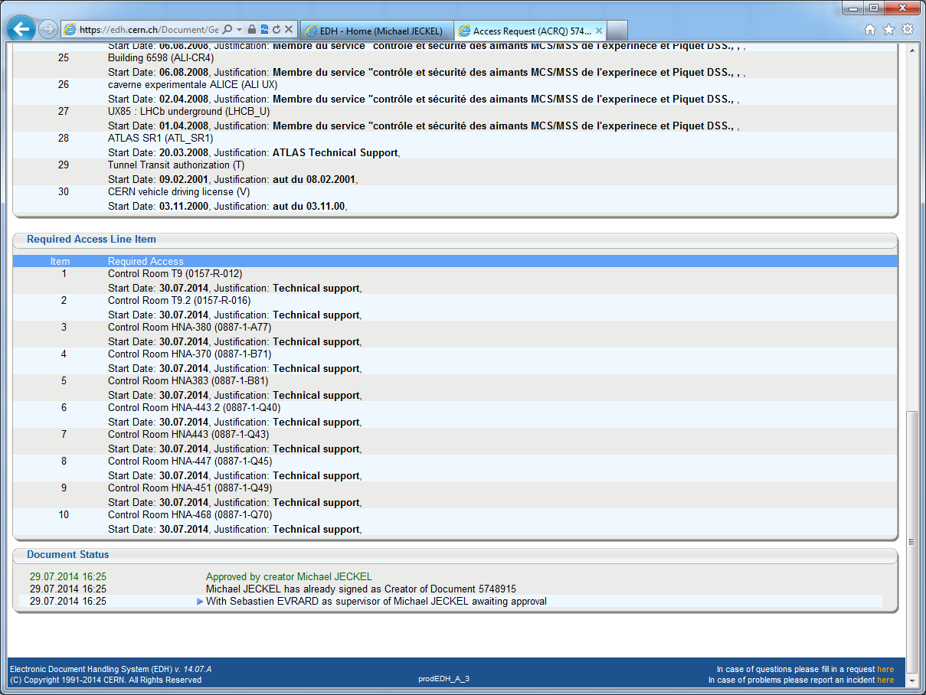

Slide 4
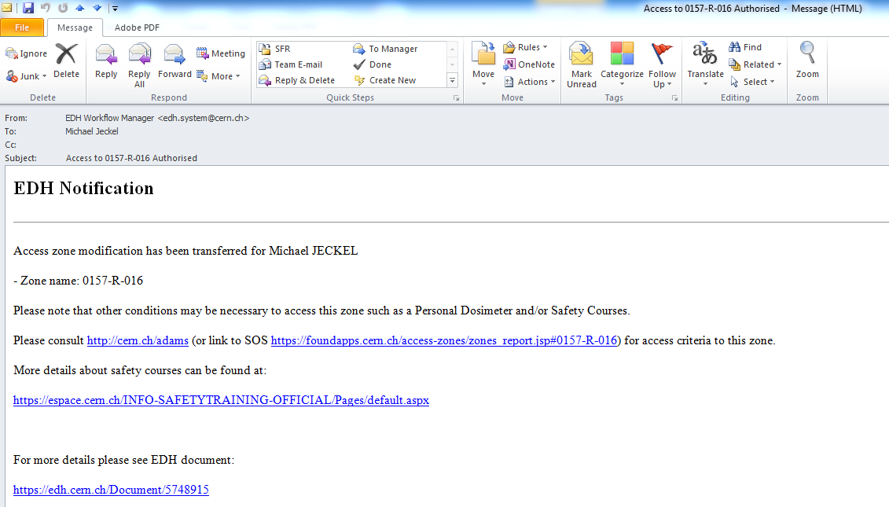
Only after receiving this kind of notification
you can go to an online reader to activate your CERN card.

Slide 5
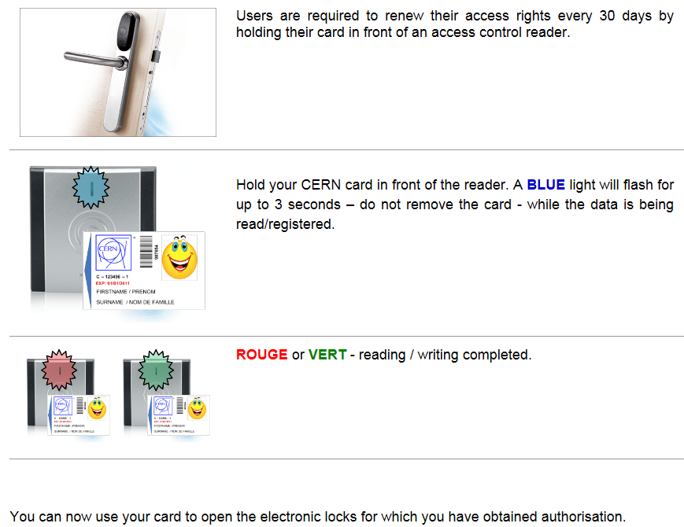
http://gs-dep.web.cern.ch/en/content/Electronic_locks

Slide 6
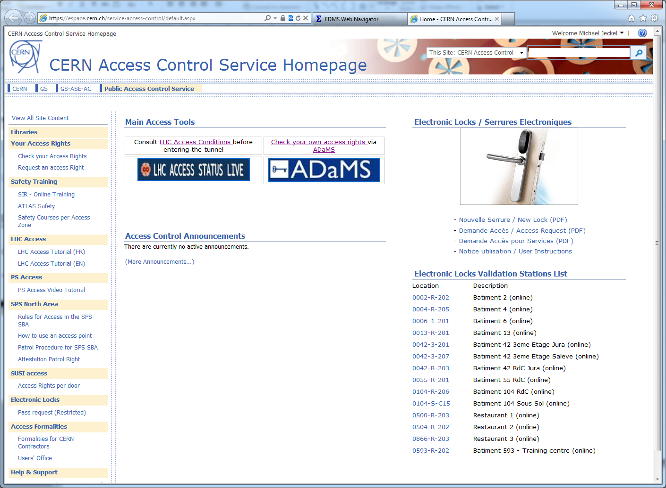
https://espace.cern.ch/service-access-control/default.aspx

Slide 7
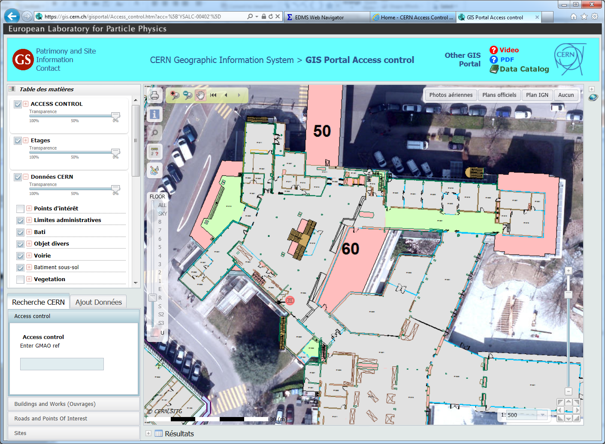
Online reader @ R1

Slide 8
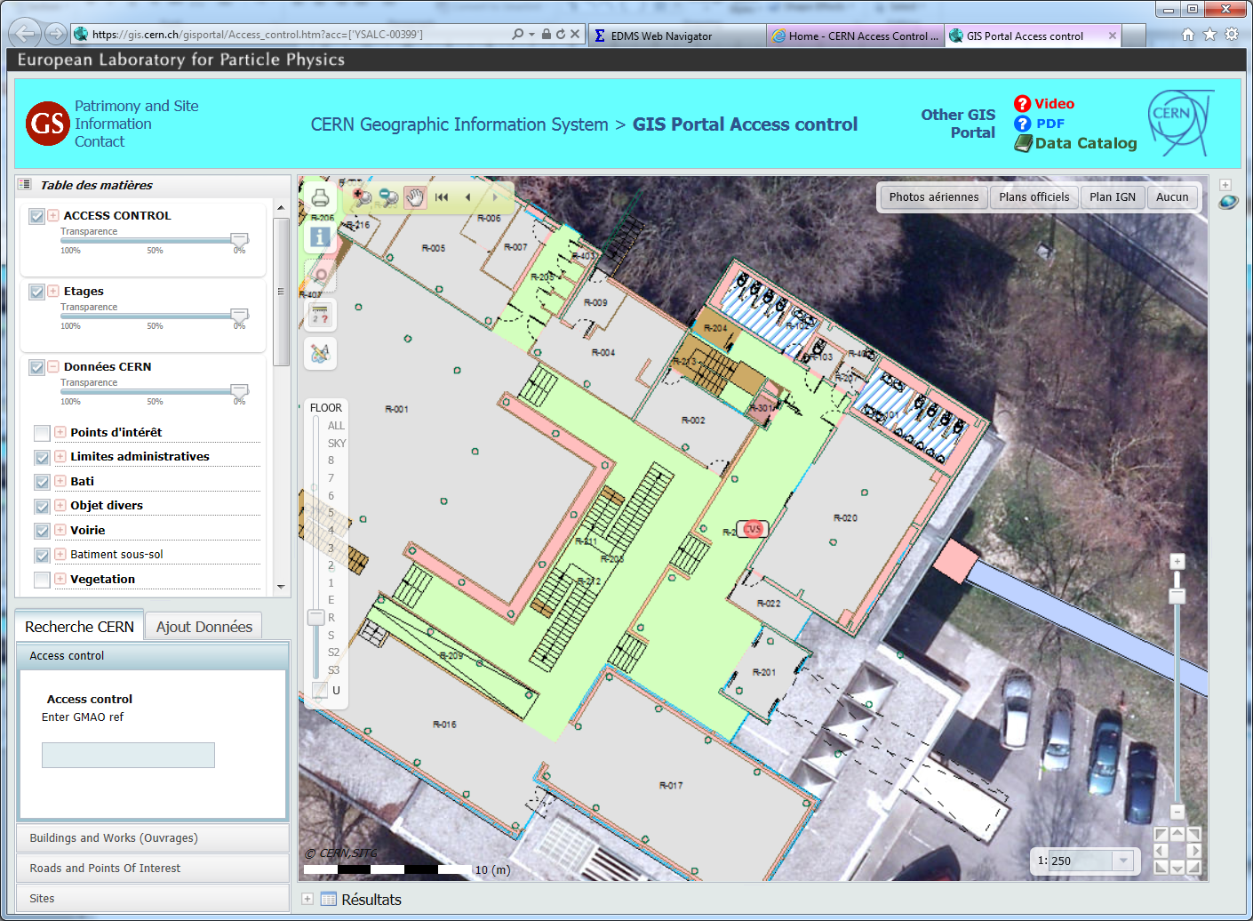

Online reader @ R2

Slide 9
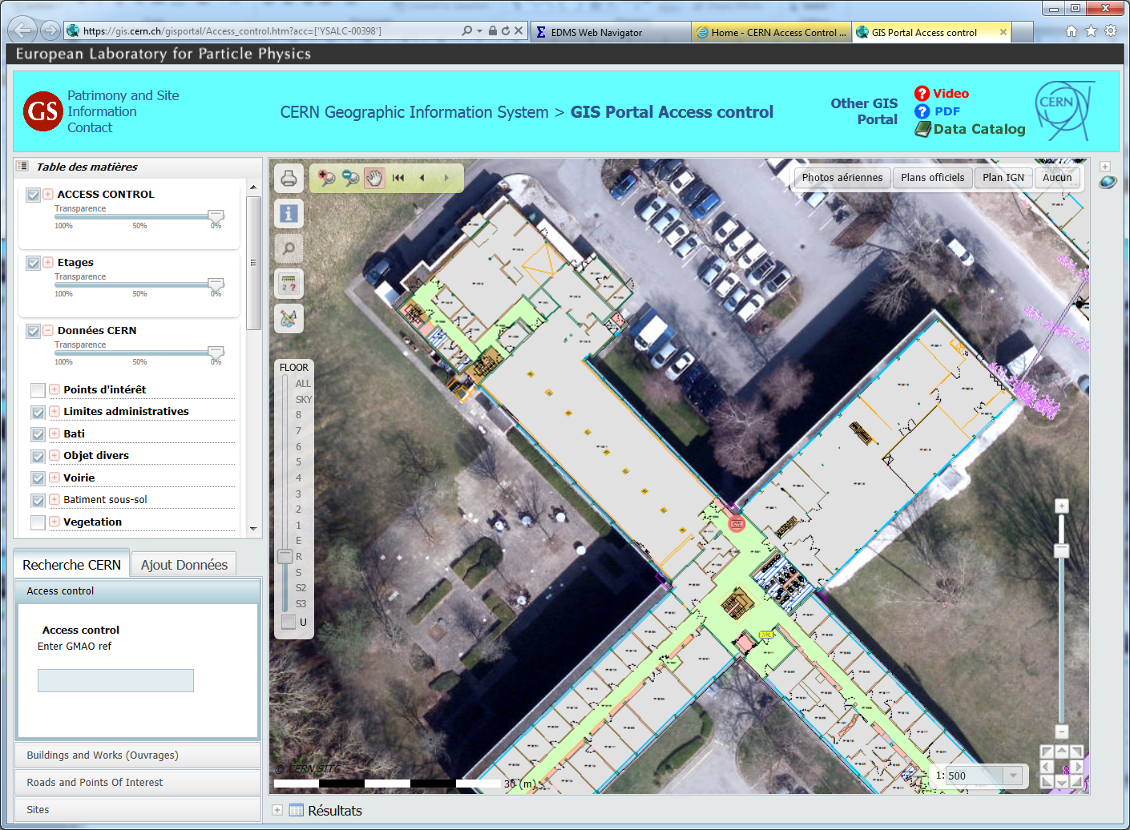
Online reader @ R3

Slide 10
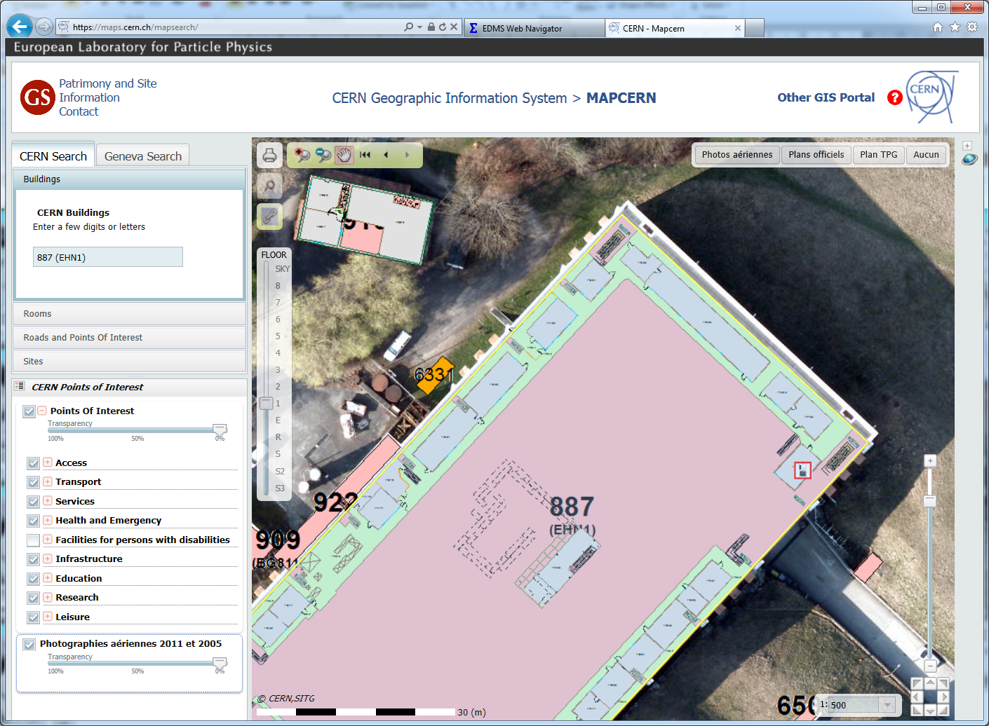
Online reader @ EHN1

